Slide 1

Join the community and start practicing!

Slide 2
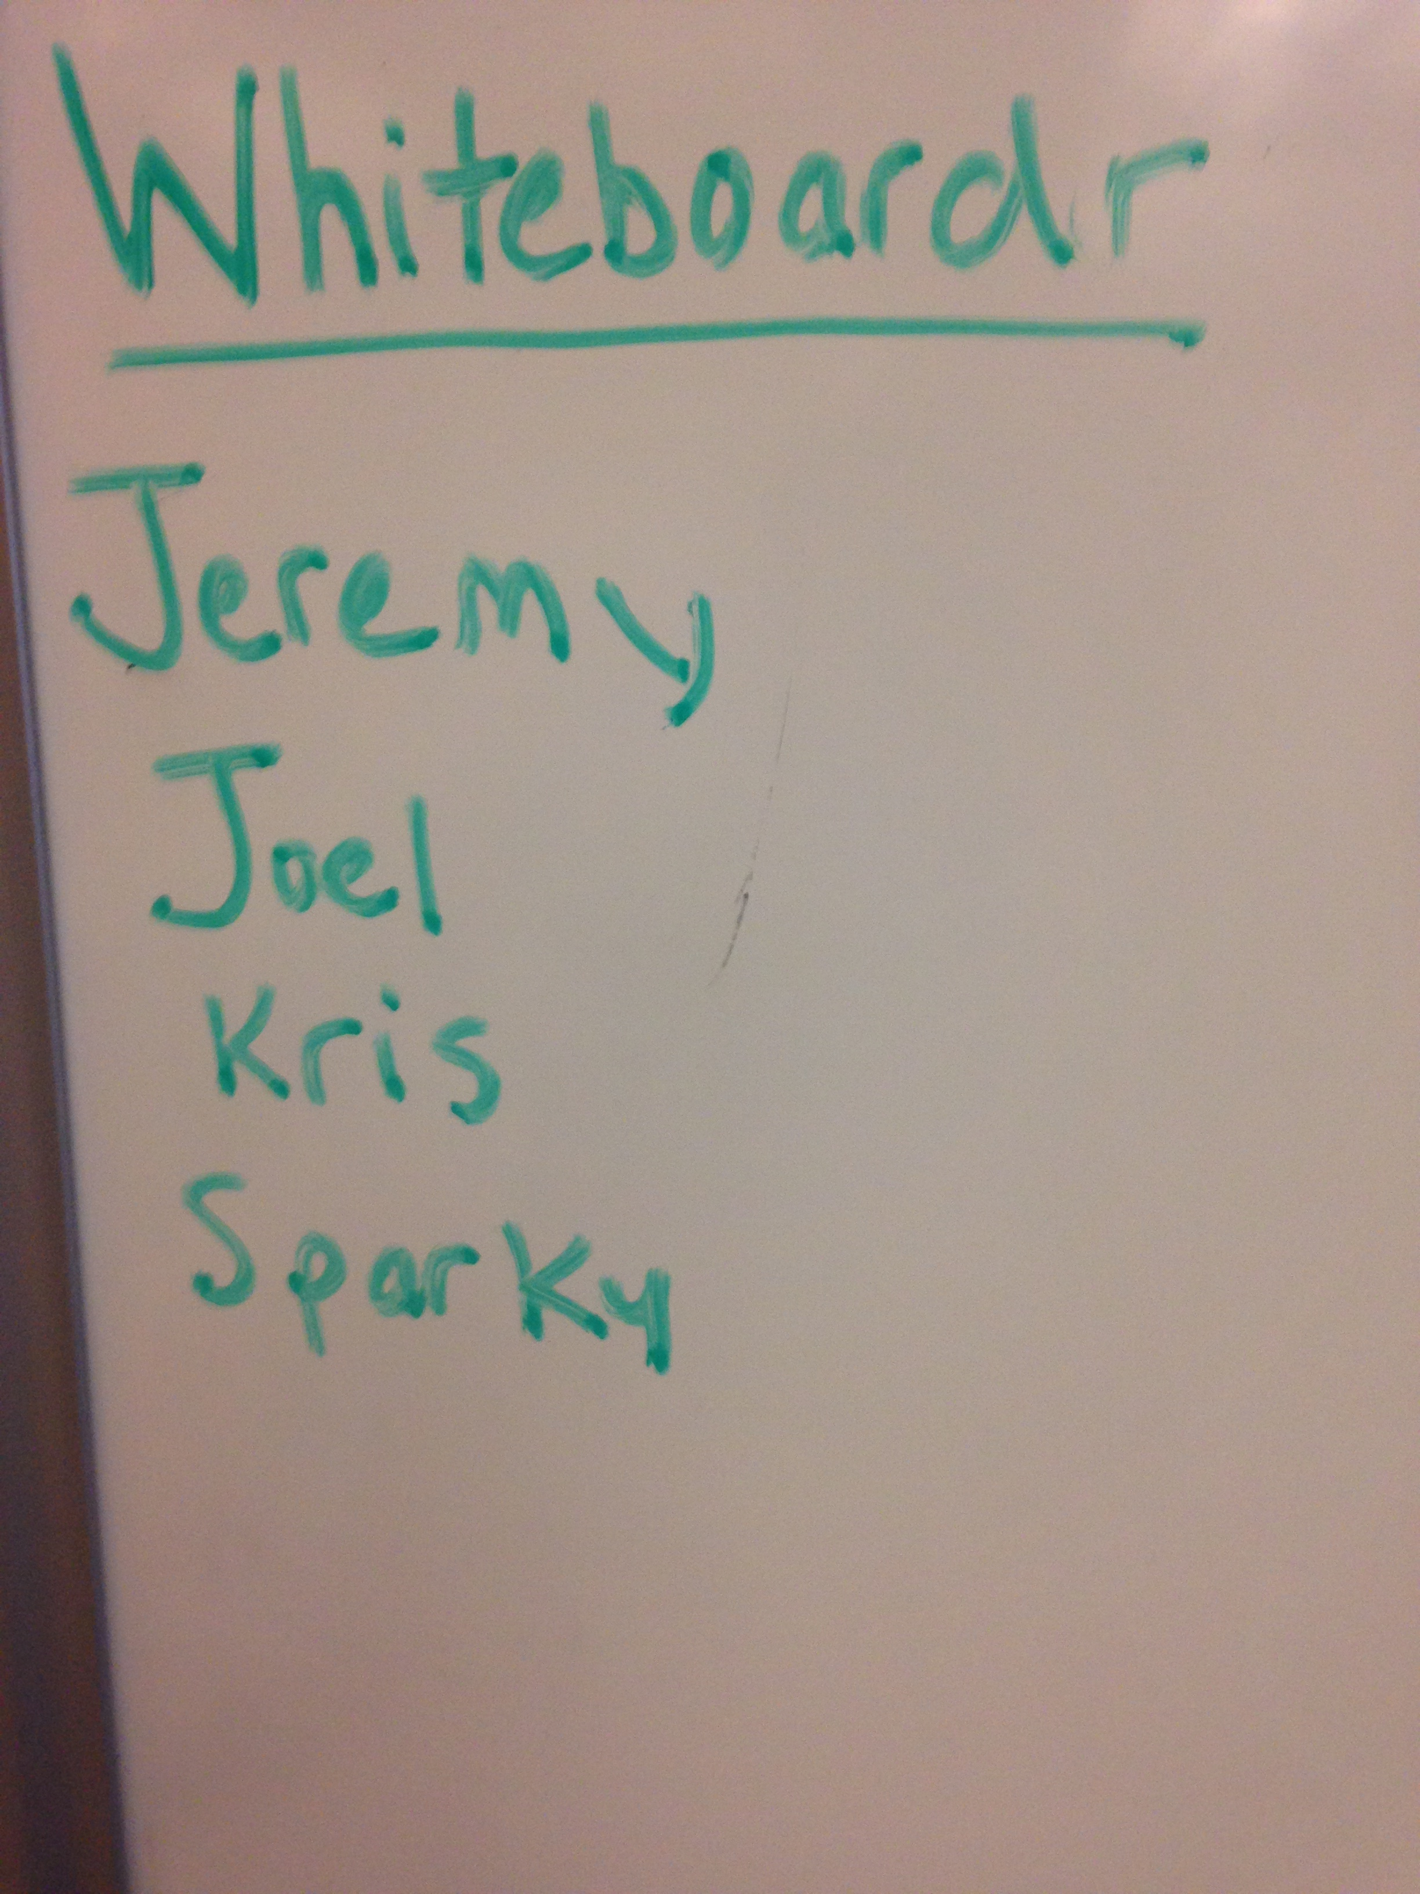
Our Team

Slide 3
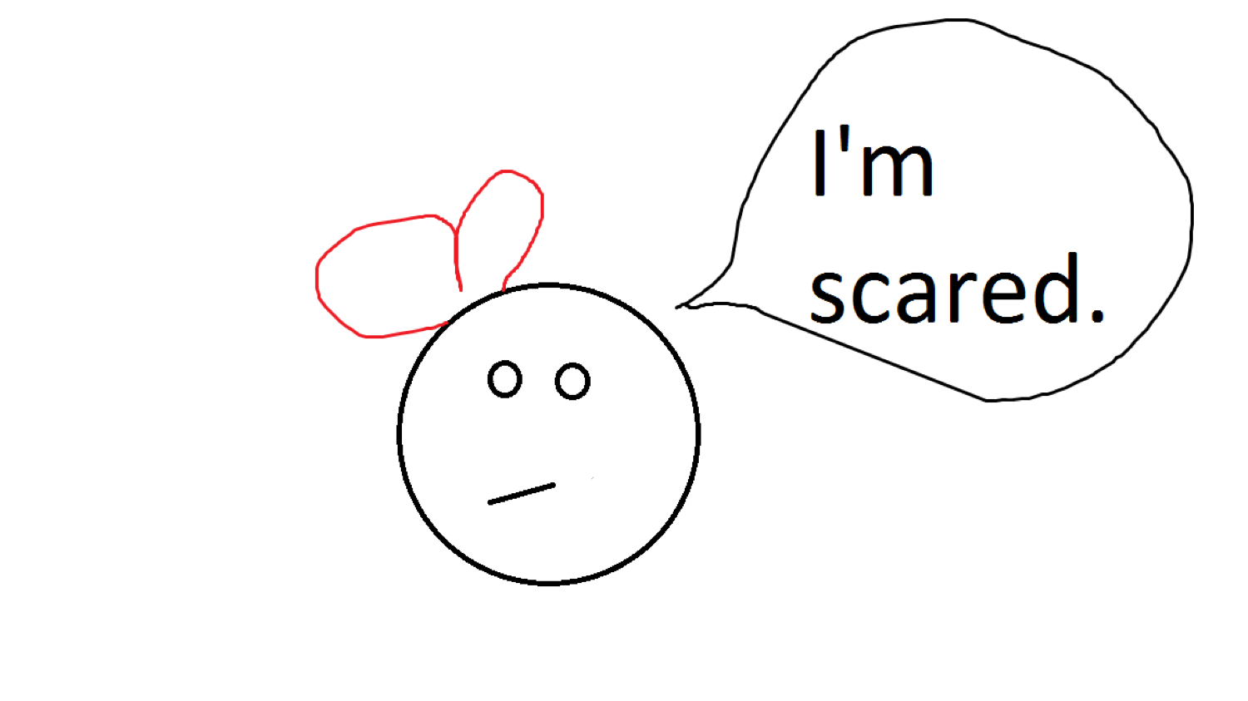
It’s Scary Up There!
Performance anxiety
Unknown challenge - > extra stress
Whiteboarding is different than coding with keyboard
Feedback from real interviewers not often given

Slide 4
Practice and Feedback are the Stepping Stones to Competency
Gather a group
Pick an interviewer, a job candidate, and a challenge
Reviewers leave feedback
Upload a photo of whiteboard
Candidates review feedback

Slide 5

To the Rescue!
Demo

Slide 6
Technologies Used
Ruby/Rails
PostgreSQL
Heroku
Simplecov
Circle CI
Bootstrap
DragonFly
Dropbox
Sorcery

Slide 7
Team Dynamics
Team norms
Special stand up ritual
Some pairing/some individual work
We were a task-oriented team!

Slide 8
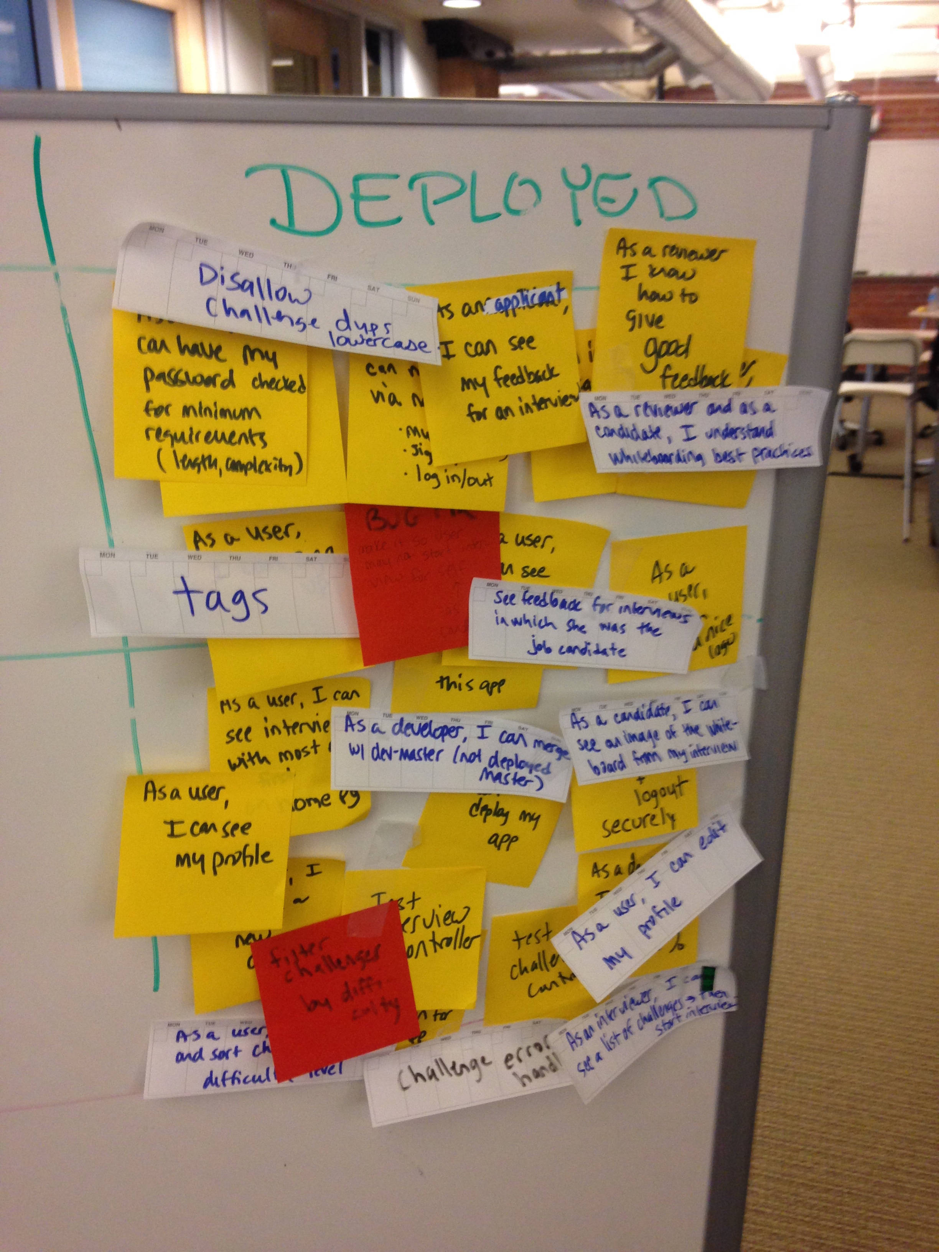
Progress is Happiness!

Slide 9
Successes
Small MVP – complete and deployed by Saturday
NVP
Small steps, lots of commits
Good communication and encouragement
Fun (100% covfefe)

Slide 10
Struggles
As we added features, the user interface became muddled – UI not intuitive
Image persistence
100% testing was time-consuming
Bogged in swamp – pair to rescue!

Slide 11
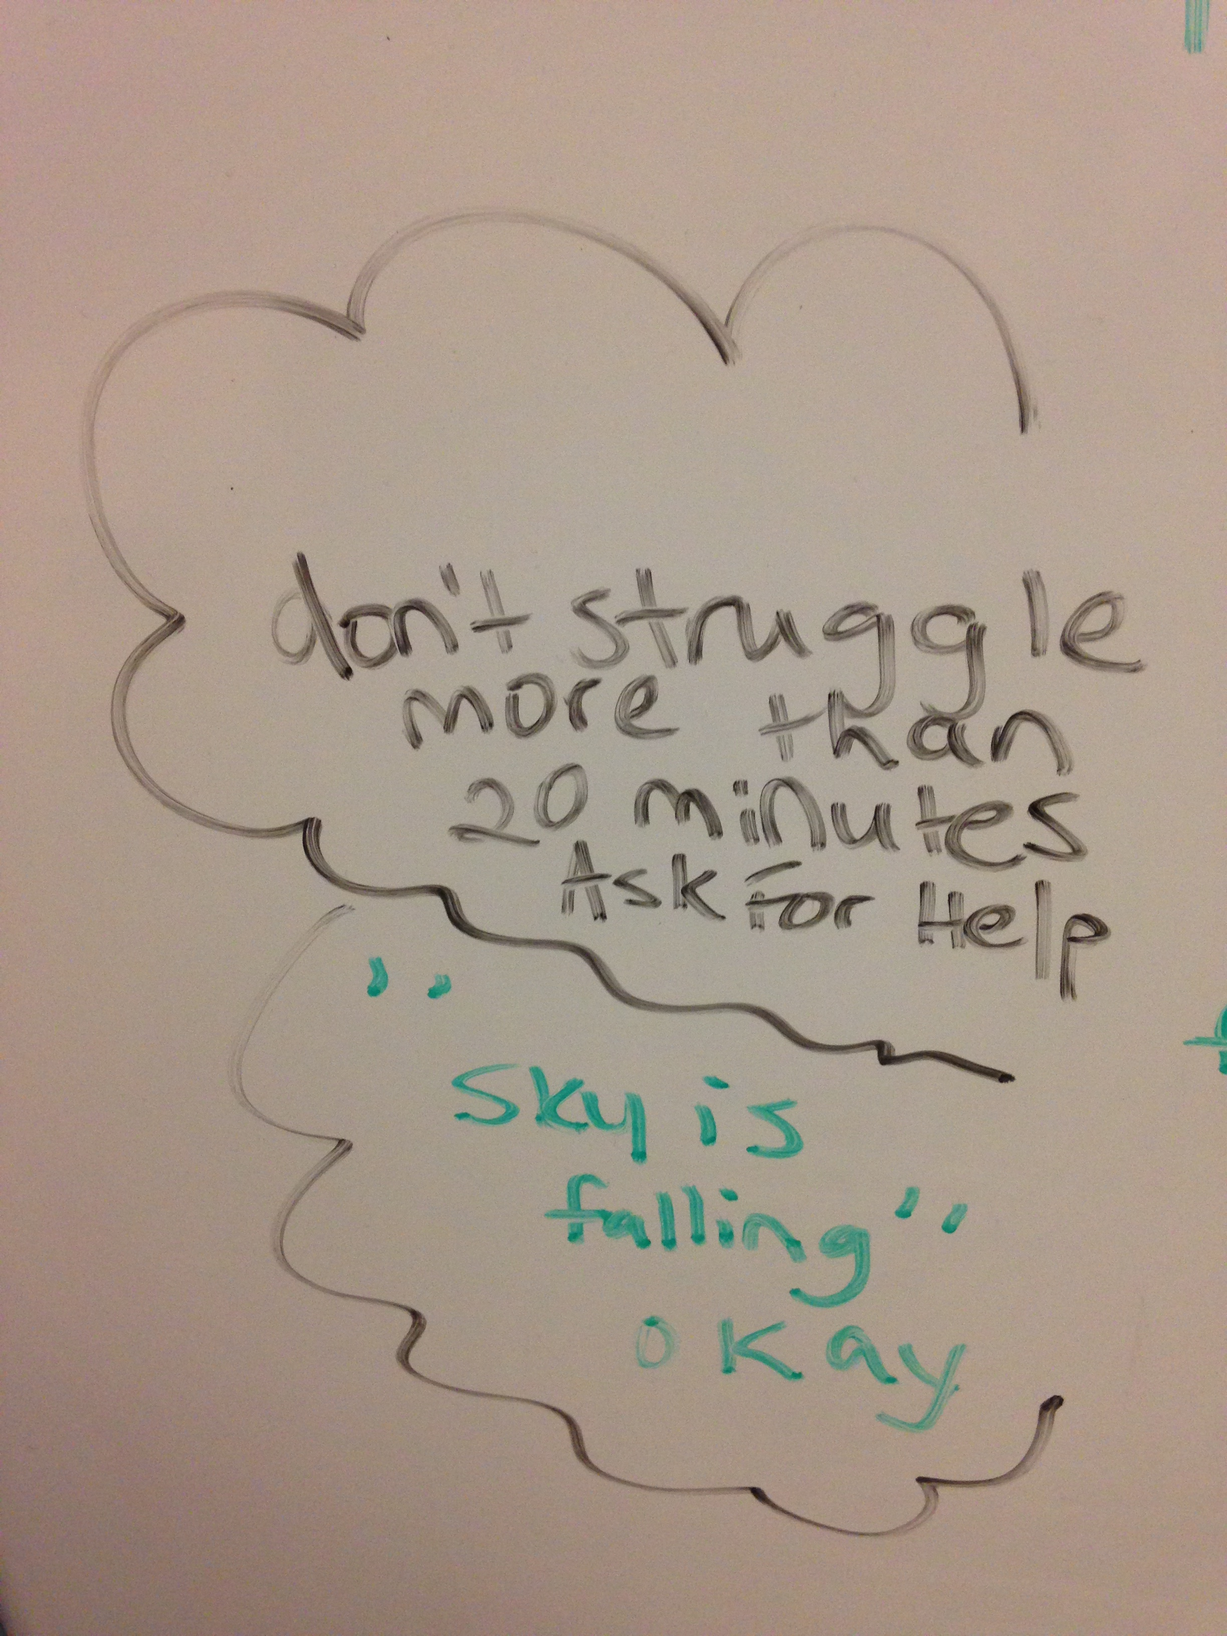
Swamp Extraction

Slide 12
Happy Whiteboarding!
Use Bootcampr to schedule whiteboarding sessions!
Use Devs4Good to use your skills to help others!
You got this!

